Slide 1
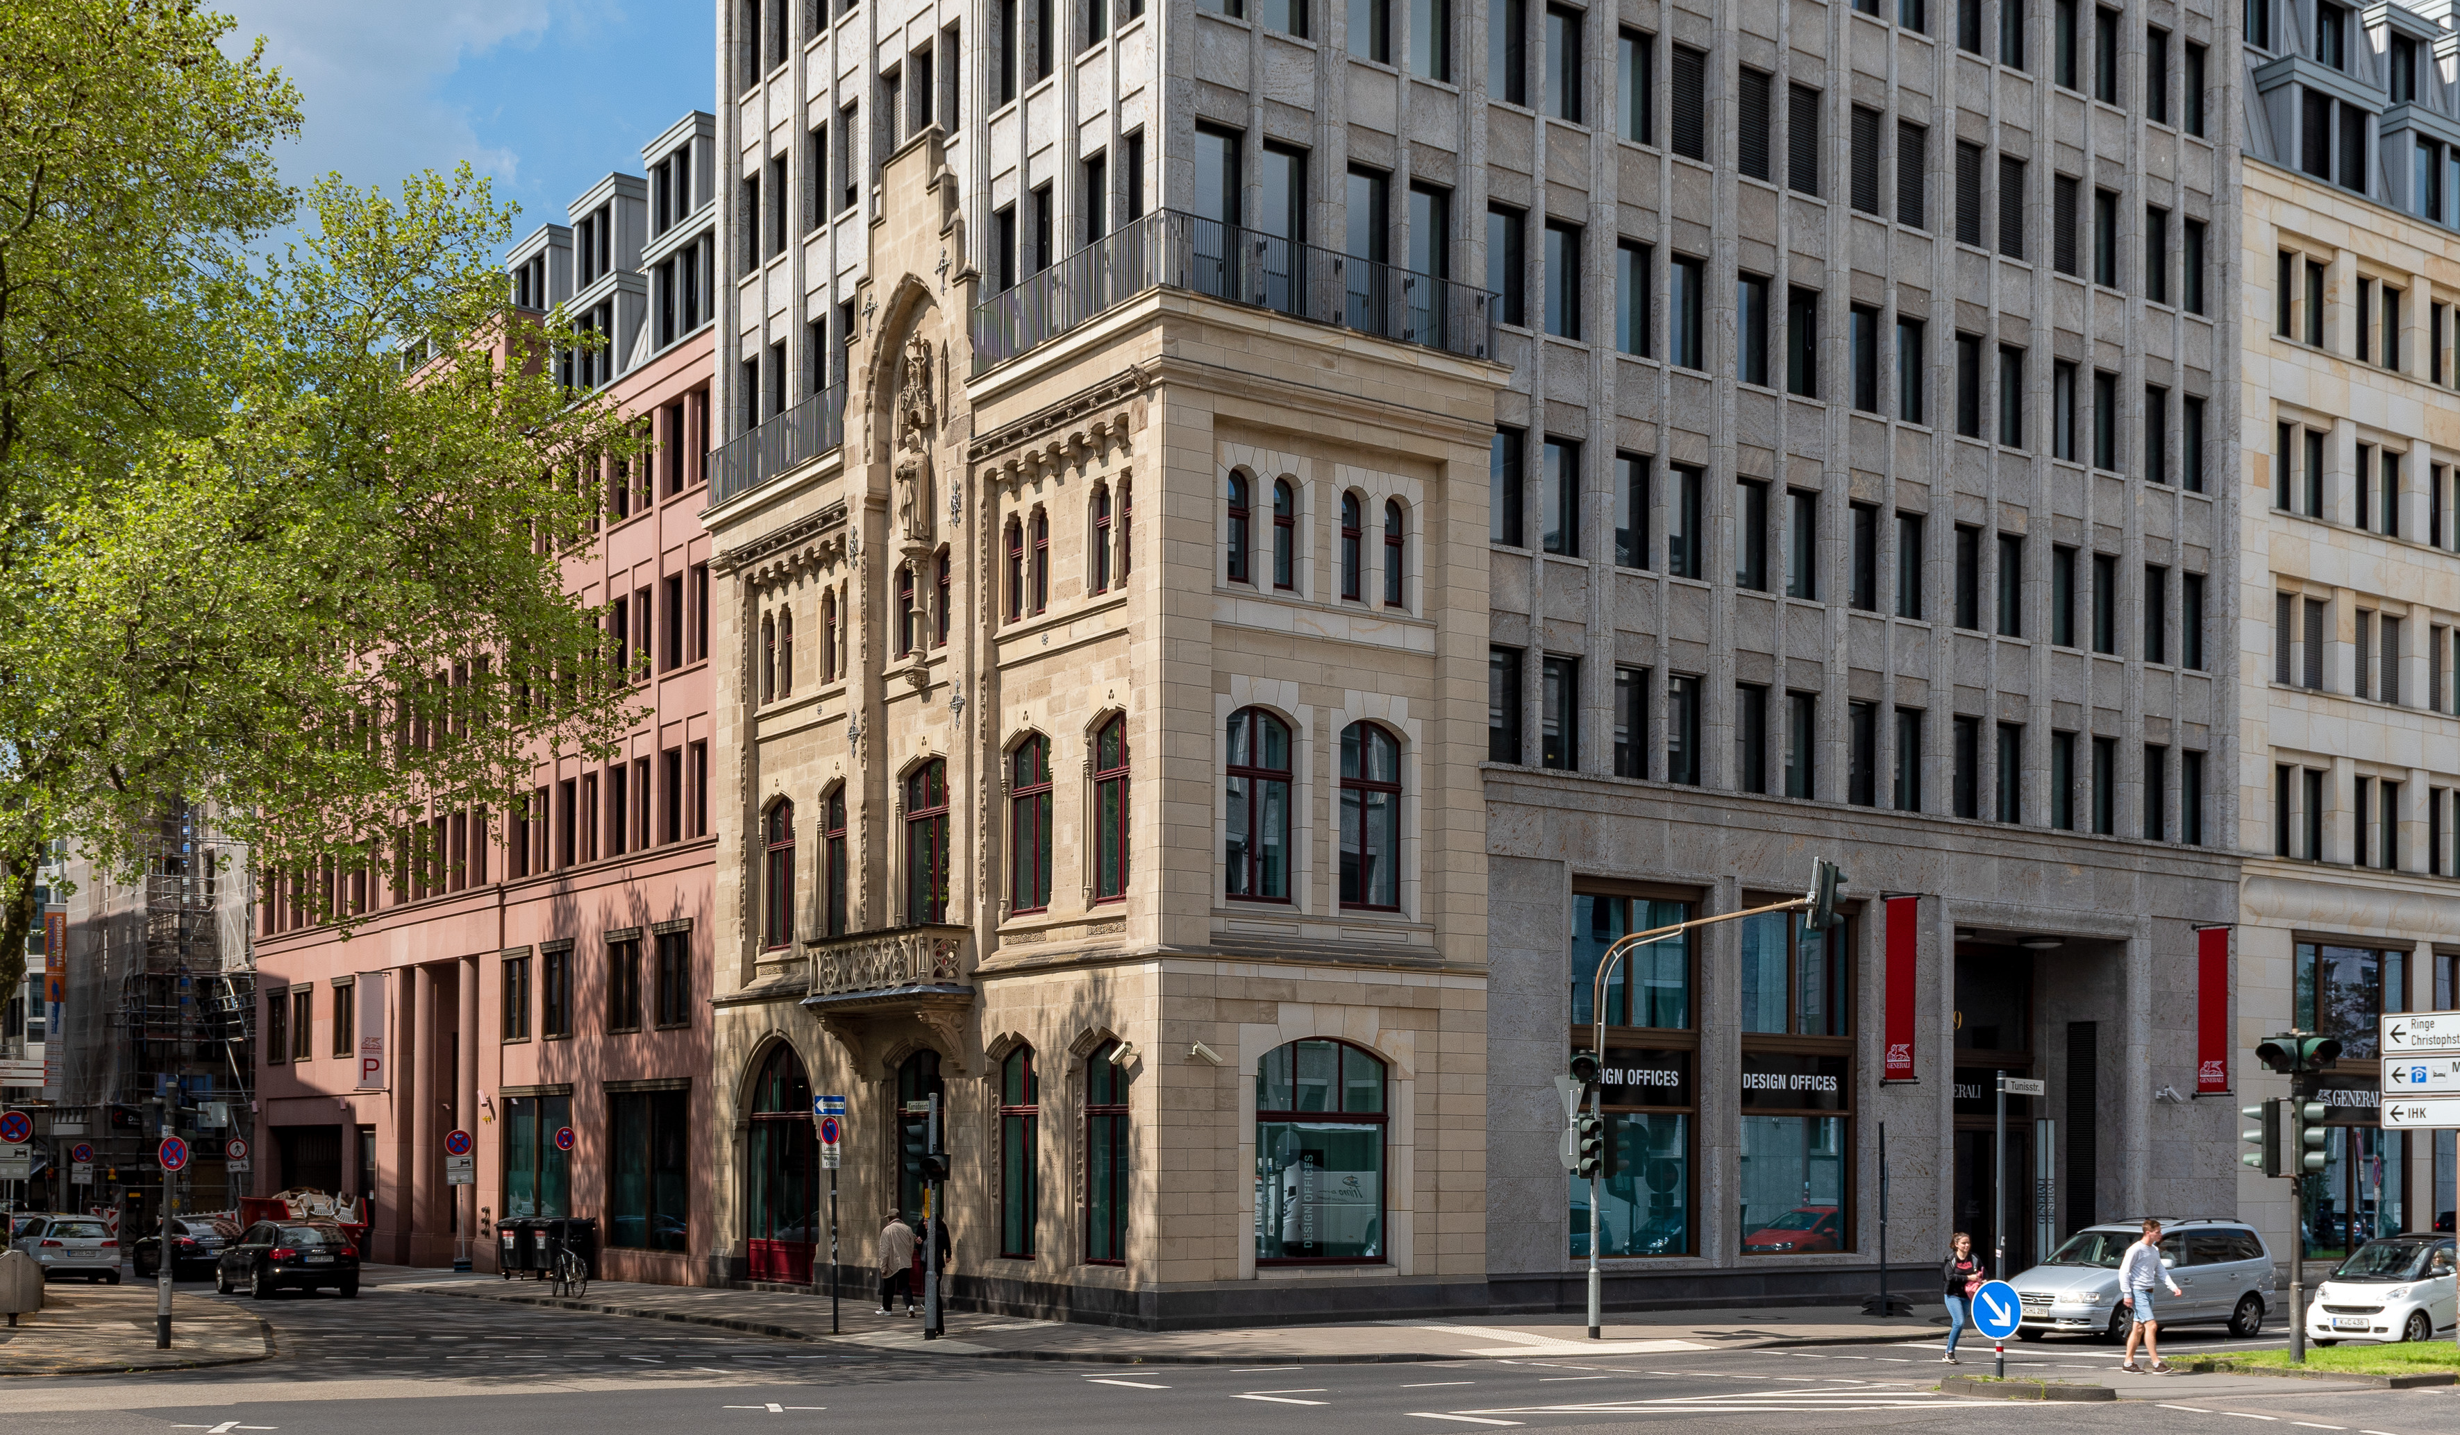
Grundrisse
Köln Dominium
STANDORTINFORMATIONEN

Slide 2
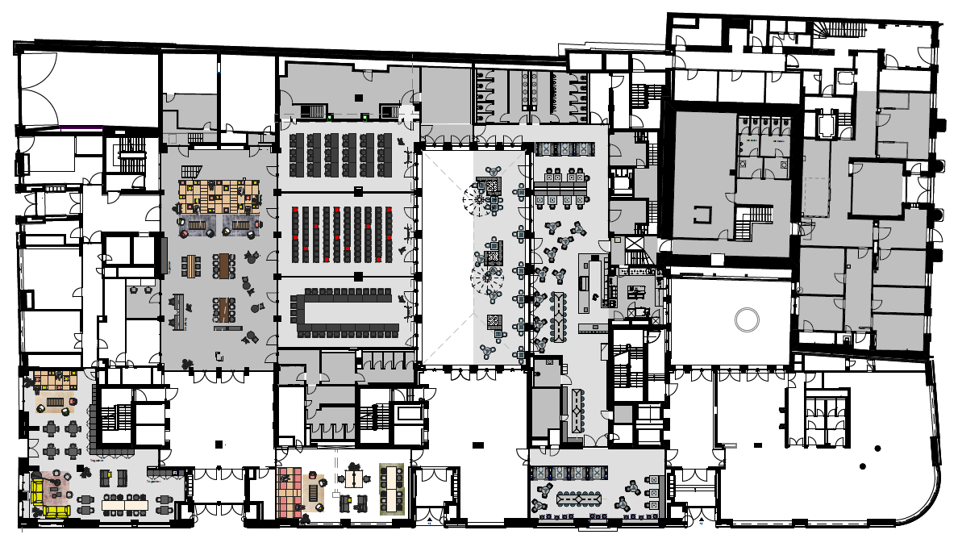
EG 00
Zusammengestellt durch flexible Wände
Meetings & Conference Spaces
Training Room I
Training Room II
Training Room III
Training Room I + II
Training Room II + III
Training Room II, II, III
DO.Lounge
Empfang
1
1
4
2
6
2
3
5
4
3
8
5
STANDORTINFORMATIONEN
6
7
7
8

Slide 3







EG 00
Meetings & Conference Spaces
 | m² | L x B x H in Metern | New Work | U-Form | Parlament | Theater | Block | Stuhlkreis | Bankett
Training Room I | 94 | 7,0 x 13,0 x 3,1 | 25 | 24 | 24 | 70 | 20 | 15 | 24
Training Room II | 100 | 8,0 x 13,0 x 3,1 | 30 | 24 | 24 | 70 | 20 | 17 | 30
Training Room III | 91 | 7,0 x 13,0 x 3,1 | 25 | 24 | 24 | 70 | 20 | 15 | 24
Training Room I + II | 194 | 15,0 x 13,0 x 3,1 | 80 |  | 72 | 120 |  |  | 54
Training Room II + III | 191 | 15,0 x 13,0 x 3,1 | 80 |  | 72 | 120 |  |  | 54
Training Room I, II, III | 285 | 22,0 x 13,0 x 3,1 | 120 |  | 90 | 199 |  |  | 54
DO.Lounge | 94 | 7,0 x 13,0 x 3,1 | 25 | 24 | 24 | 70 | 20 | 15 | 24
Empfang | 100 | 8,0 x 13,0 x 3,1 | 30 | 24 | 24 | 70 | 20 | 17 | 30
1
2
3
4
5
STANDORTINFORMATIONEN
6
7
8

Slide 4
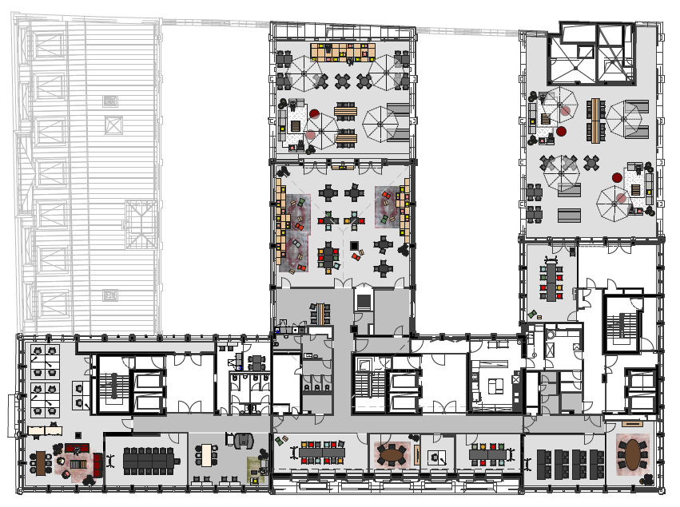
OG 07
Meetings & Conference Spaces
5
Training Room 7.I
Fireside Room 7.I
Fireside Room 7.II
Meet & Move Room
Work Lab 7.I
4
1
2
STANDORTINFORMATIONEN
3
4
1
2
3
5

Slide 5
OG 07
Meetings & Conference Spaces
 | m² | L x B x H in Metern | New Work | U-Form | Parlament | Theater | Block | Stuhlkreis | Bankett
Training Room 7.I | 39 | 7,9 x 4,9 x 2,8 | 15 | 12 | 10 | 18 | 10 | 10 | 12
Fireside Room 7.I | 19 | 4,9 x 3,8 x 2,45 |  |  |  |  | 6
Fireside Room 7.II | 29 | 6,2 x 4,7 x 2,8 |  |  |  |  | 6
Meet & Move Room | 36 | 7,5 x 4,85 x 2,85 |  |  |  |  | 8
Work Lab 7.I | 153 | 12,9 x 11,8 x 2,85 | 40 | 20 | 25 | 60 | 18 | 25 | 24
1
2
STANDORTINFORMATIONEN
3
4
5

