Slide 1
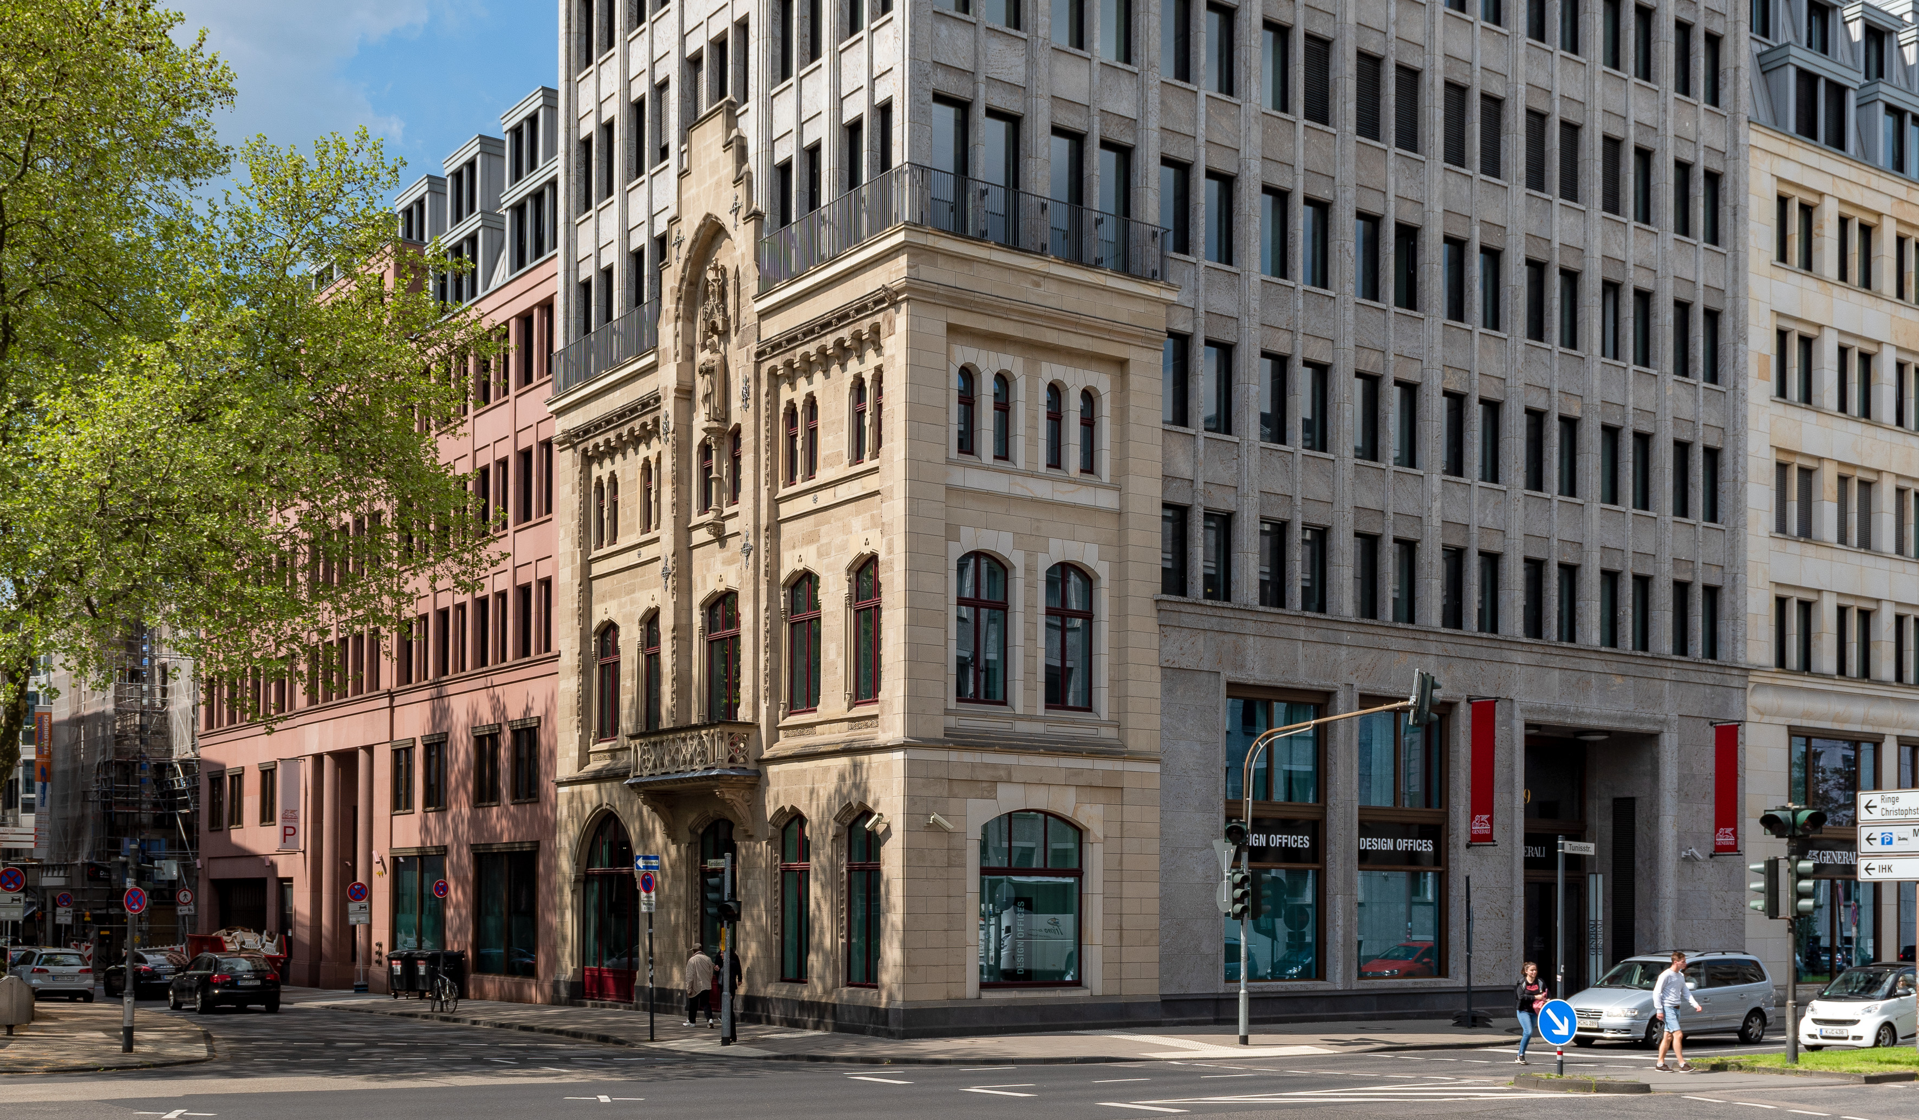
Floor plans
Cologne Dominium
LOCATION INFORMATION

Slide 2
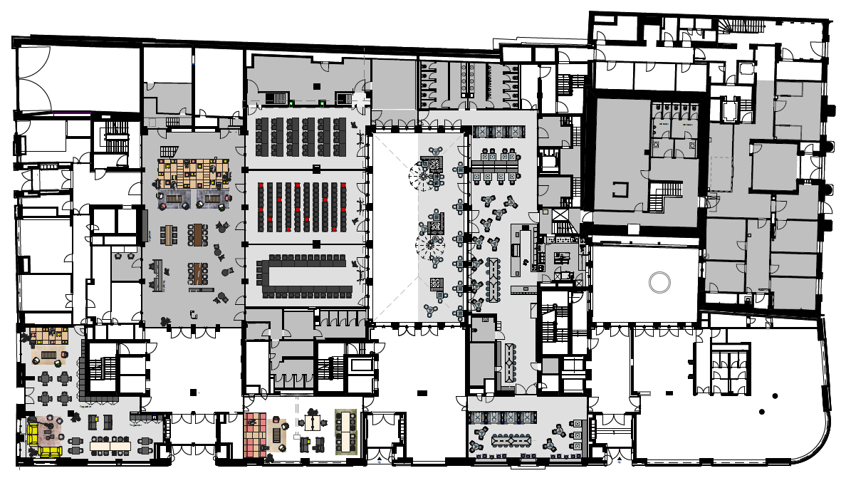
Ground floor
With flexible walls
Meetings & Conference Spaces
Training Room I
Training Room II
Training Room III
Training Room I + II
Training Room II + III
Training Room II, II, III
DO.Lounge
Reception
1
1
4
2
6
2
3
5
4
8
3
5
LOCATION INFORMATION
6
7
7
8

Slide 3







Ground floor
Meetings & Conference Spaces
 | m² | L x W x H in metres | New Work | U-shaped | Parliamentary | Theatre | Block | Circle | Banquet
Training Room I | 94 | 7.0 x 13.0 x 3.1 | 25 | 24 | 24 | 70 | 20 | 15 | 24
Training Room II | 100 | 8.0 x 13.0 x 3.1 | 30 | 24 | 24 | 70 | 20 | 17 | 30
Training Room III | 91 | 7.0 x 13.0 x 3.1 | 25 | 24 | 24 | 70 | 20 | 15 | 24
Training Room I + II | 194 | 15.0 x 13.0 x 3.1 | 80 |  | 72 | 120 |  |  | 54
Training Room II + III | 191 | 15.0 x 13.0 x 3.1 | 80 |  | 72 | 120 |  |  | 54
Training Room I, II, III | 285 | 22.0 x 13.0 x 3.1 | 120 |  | 90 | 199 |  |  | 54
DO.Lounge | 94 | 7.0 x 13.0 x 3.1 | 25 | 24 | 24 | 70 | 20 | 15 | 24
Reception | 100 | 8.0 x 13.0 x 3.1 | 30 | 24 | 24 | 70 | 20 | 17 | 30
1
2
3
4
5
LOCATION INFORMATION
6
7
8

Slide 4
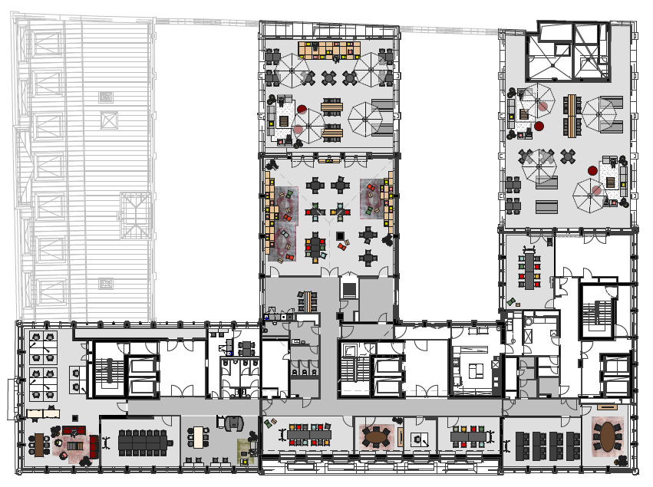
7th floor
Meetings & Conference Spaces
5
Training Room 7.I
Fireside Room 7.I
Fireside Room 7.II
Meet & Move Room
Work Lab 7.I
4
1
2
LOCATION INFORMATION
3
4
1
2
3
5

Slide 5
7th floor
Meetings & Conference Spaces
 | m² | L x W x H in metres | New Work | U-shaped | Parliamentary | Theatre | Block | Circle | Banquet
Training Room 7.I | 39 | 7.9 x 4.9 x 2.8 | 15 | 12 | 10 | 18 | 10 | 10 | 12
Fireside Room 7.I | 29 | 6.2 x 4.7 x 2.8 |  |  |  |  | 6
Fireside Room 7.II | 19 | 4.9 x 3.8 x 2.45 |  |  |  |  | 6
Meet & Move Room | 36 | 7,5 x 4,85 x 2,85 |  |  |  |  | 8
Work Lab 7.I | 153 | 12.9 x 11.8 x 2.85 | 40 | 20 | 25 | 60 | 18 | 25 | 24
1
2
LOCATION INFORMATION
3
4
5

