Slide 1
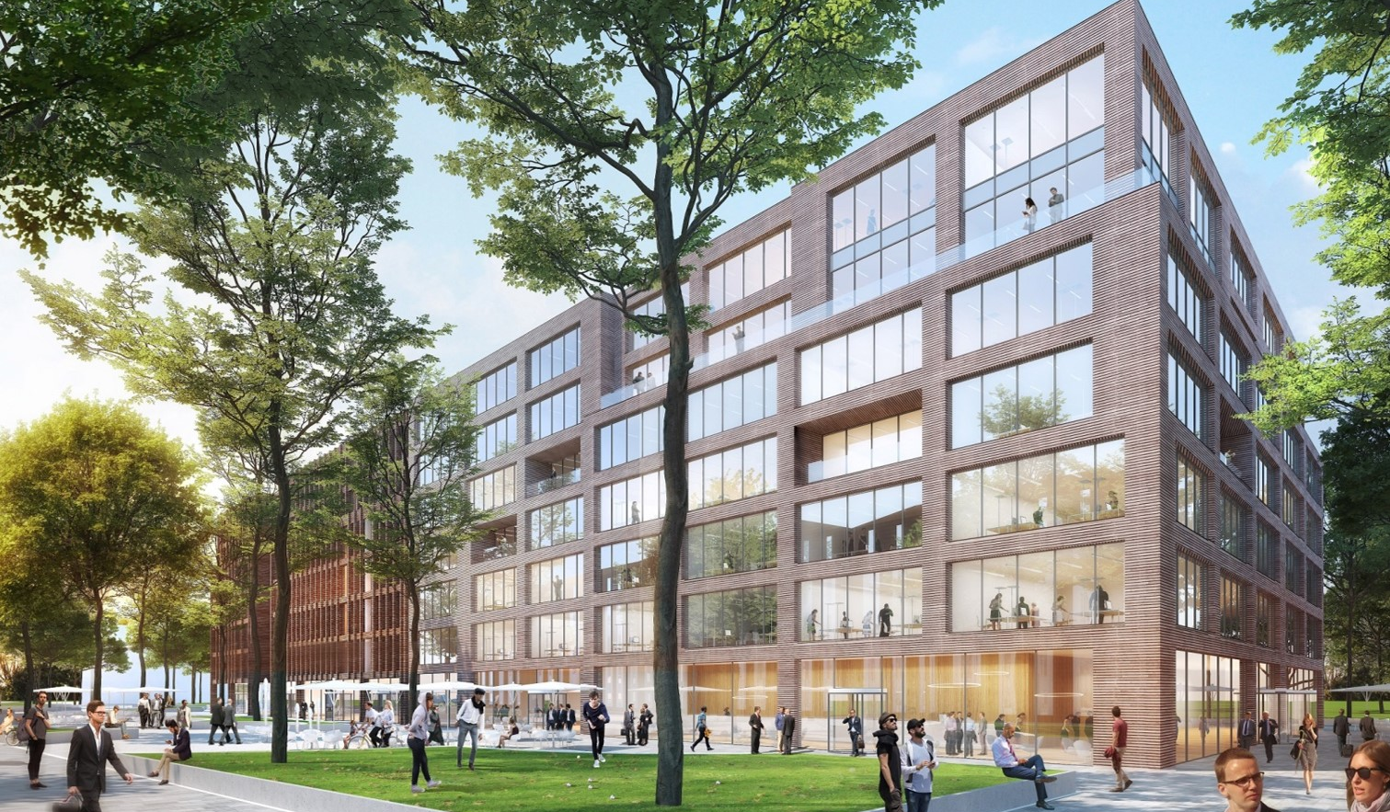
Grundrisse
Köln Schanzenstraße
STANDORTINFORMATIONEN

Slide 2
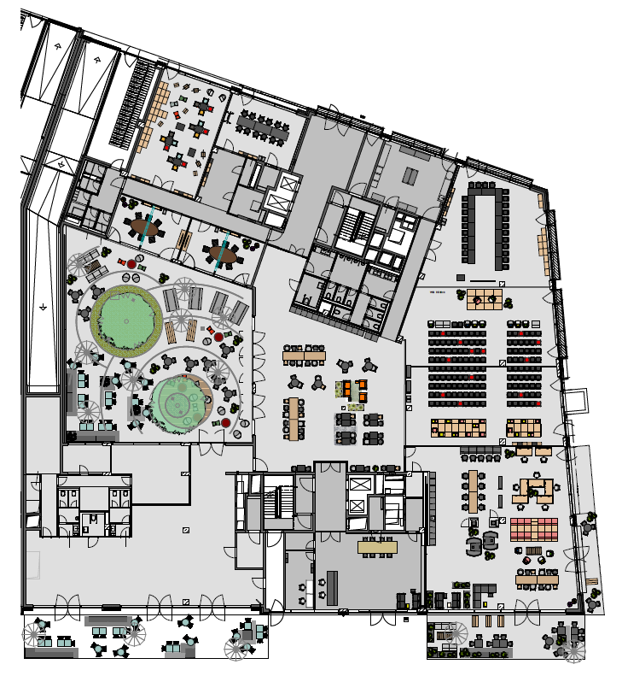
EG 00
Zusammengestellt durch flexible Wände
Meetings & Conference Spaces
2
1
Training Room I
Meet & Move Room
Fireside Room I
Fireside Room II
Eatery
Work Lab
Training Room II
Training Room III
Training Room II + III
Empfang
Innenhof
1
3
6
4
2
3
7
4
11
5
9
5
8
6
7
8
STANDORTINFORMATIONEN
9
10
10
11

Slide 3







EG 00
Bestuhlungsplan
 | m² | L x B x H in Metern | New Work | U-Form | Parlament | Theater | Block | Stuhlkreis | Bankett
Training Room I | 86 |  | 35 | 20 | 40 | 60 | 20 | 20
Meet & Move Room | 47 |  |  |  |  |  | 12
Fireside Room I | 36 |  |  |  |  |  | 8
Fireside Room II | 37 |  |  |  |  |  | 8
Eatery
Work Lab | 127 |  | 50 | 30 | 40 | 65 | 20 | 20
Training Room II | 122 |  | 40 | 20 | 36 | 65 | 30 | 20
Training Room III | 128 |  | 40 | 20 | 36 | 65 | 30 | 20
Training Room II + III | 250 |  | 140 |  | 80 | 200+
Empfang |  |  | Außergewöhnliche Outdoor-Möblierung
Innenhof | 86 |  | 35 | 20 | 40 | 60 | 20 | 20
1
2
3
4
5
6
7
8
STANDORTINFORMATIONEN
9
10
11

