Slide 1
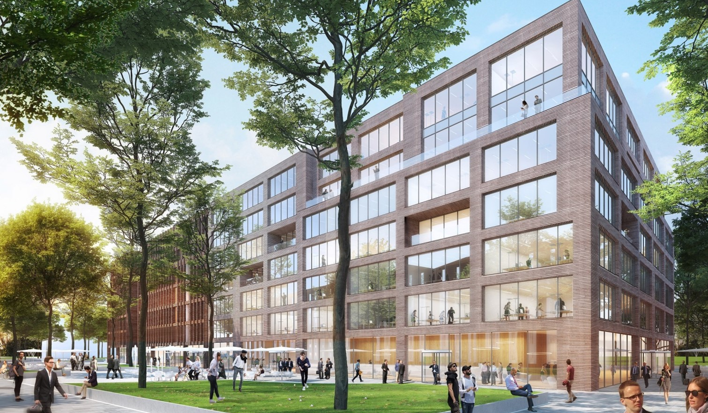
Floor plans
Cologne Schanzenstrasse
LOCATION INFORMATION

Slide 2
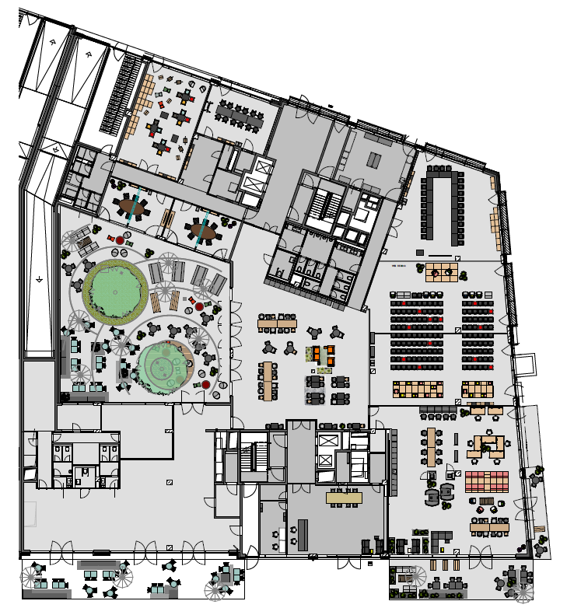
GROUND Floor
With flexible walls
Flexible walls
Meetings & Conference Spaces
2
1
Training Room I
Meet & Move Room
Fireside Room I
Fireside Room II
Eatery
Work Lab
Training Room II
Training Room III
Training Room II + III
Reception
Courtyard
1
3
6
4
2
3
7
4
11
5
9
5
8
6
7
8
LOCATION INFORMATION
9
10
10
11

Slide 3







GROUND Floor
Seating Plan
 | m² | L x W x H in metres | New Work | U-shaped | Parliamentary | Theatre | Block | Circle | Banquet
Training Room I | 86 |  | 35 | 20 | 40 | 60 | 20 | 20
Meet & Move Room | 47 |  |  |  |  |  | 12
Fireside Room I | 36 |  |  |  |  |  | 8
Fireside Room II | 37 |  |  |  |  |  | 8
Eatery
Work Lab | 127 |  | 50 | 30 | 40 | 65 | 20 | 20
Training Room II | 122 |  | 40 | 20 | 36 | 65 | 30 | 20
Training Room III | 128 |  | 40 | 20 | 36 | 65 | 30 | 20
Training Room II + III | 250 |  | 140 |  | 80 | 200+
Reception |  |  | Unique outdoor furniture
Courtyard | 86 |  | 35 | 20 | 40 | 60 | 20 | 20
1
2
3
4
5
6
7
8
LOCATION INFORMATION
9
10
11

