Slide 1
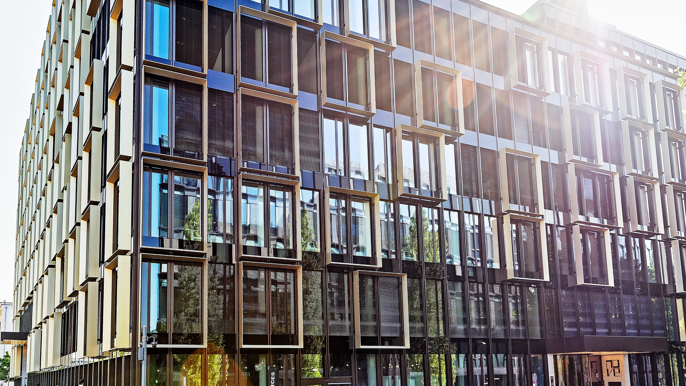

München Nove
Standortportfolio

Slide 2
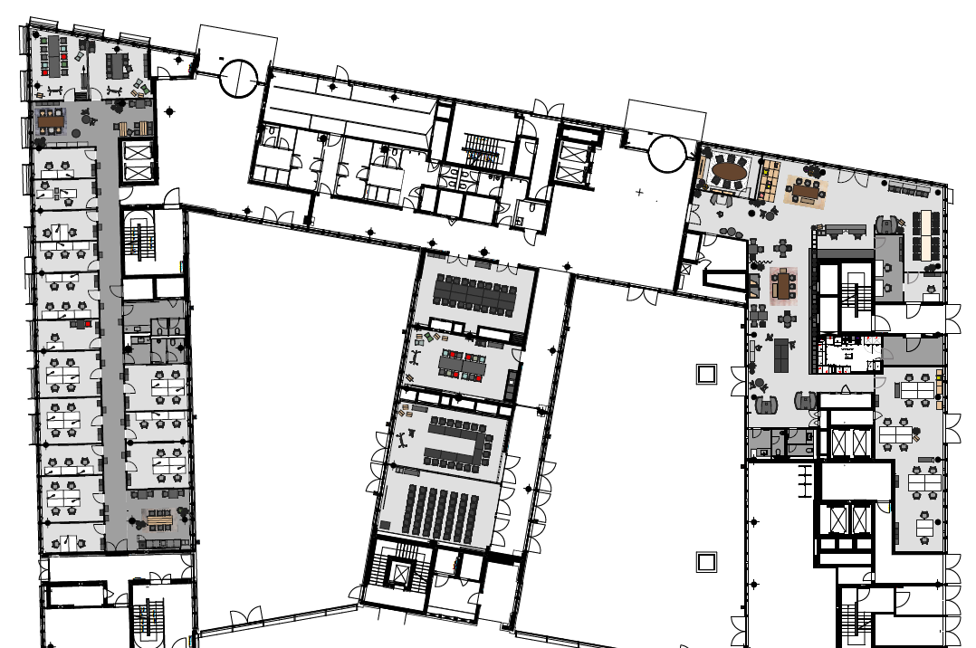
EG 00
Flexible Wand
Meeting & Conference Spaces
Office Spaces
COMING SOON
6
Training Room I
Training Room II
Training Room III
Meet & Move Room
Training Room V
Fireside Room
DO.Lounge
Empfang
8
7
5
1
4
2
2
3
3
4
1
5
STANDORTINFORMATIONEN
6
7
8

Slide 3







EG 00
Bestuhlungsplan
 | m² | L x B x H in Metern | New Work | U-Form | Parlament | Theater | Block | Stuhlkreis | Bankett
Training Room I | 56 | 5,7 x 9,9 x 3,2 | 30 | 18 | 24 | 40 | 16 | 20
Training Room II | 56 | 5,7 x 9,9 x 3,2 | 30 | 18 | 24 | 40 | 16 | 20
Training Room III | 112 | 11,5 x 9,9 x 3,2 | 70 | 26 | 60 | 110 | 24 | 40
Meet & Move Room | 47 | 4,9 x 9,6 x 3,2 |  |  |  |  | 12
Training Room V | 55 | 5,7 x 9,6 x 3,2 | 30 | 16 | 18 | 40 | 16 | 20
Fireside Room | 20 | 4,0 x 5,0 x 3,2 |  |  |  |  | 6
DO.Lounge | 243 |  | Community Table, Arbeitsbereiche, Lounge-Möblierung für 100 Personen
Empfang
1
2
3
4
5
STANDORTINFORMATIONEN
6
7
8

Slide 4
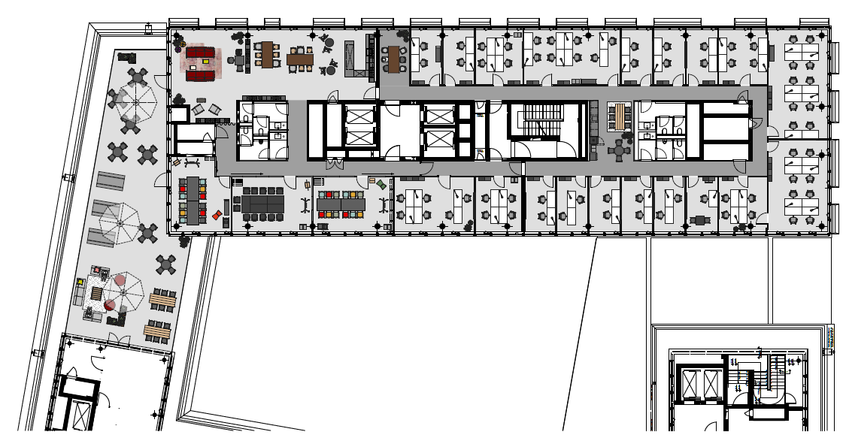
OG 06
Flexible Wände
Meeting & Conference Spaces
Office Spaces
7
Training Room VI
Training Room VII
Training Room VIII
Training Room IX (VII + VIII)
Training Room X (VI + VII)
Training Room XI (VI, VII, VIII)
Rooftop Lounge + Terrasse
Dachterrasse
8
1
3
2
1
4
5
2
6
3
4
5
STANDORTINFORMATIONEN
6
7
8

Slide 5
OG 06
Bestuhlungsplan
 | m² | L x B x H in Metern | New Work | U-Form | Parlament | Theater | Block | Stuhlkreis | Bankett
Training Room VI | 30 | 6,6 x 4,6 x 2,9 |  |  | 10 | 16 | 10 | 10
Training Room VII | 30 | 6,6 x 4,6 x 2,9 |  |  | 10 | 16 | 10 | 10 | 30
Training Room VIII | 29 | 5,0 x 6,2 x 2.9 |  |  | 10 | 16 | 10 | 10
Training Room IX (VII + VIII) | 59 | 13,2 x 4,6 x 2,9 | 40 |  | 24 | 30 | 18 | 20
Training Room X (VI + VII) | 61 | 11,7 x 4,6 x 2.9 | 40 |  | 24 | 30 | 18 | 20
Training Room XI (VI, VII, VIII) | 90 | 18,5 x 4,6 x 2,9 | 60 |  | 26 | 90 | 24 | 30
Rooftop Lounge + Terrasse | 107 | 17,0 x 6,0 | 7,7 x 2,9 | Lounge- und Bistromöblierung für 100 Personen
Dachterrasse
1
2
3
4
5
STANDORTINFORMATIONEN
6
7
8

