Slide 1
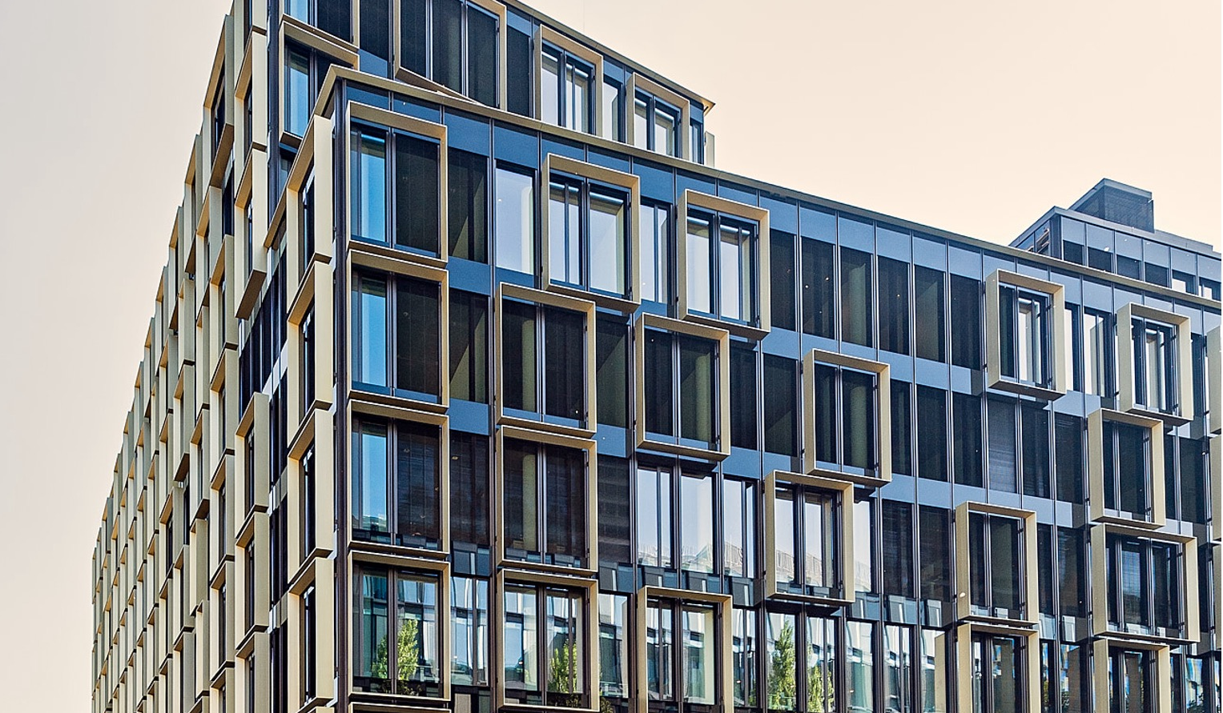
Floor plans
Munich Nove
LOCATION INFORMATION

Slide 2
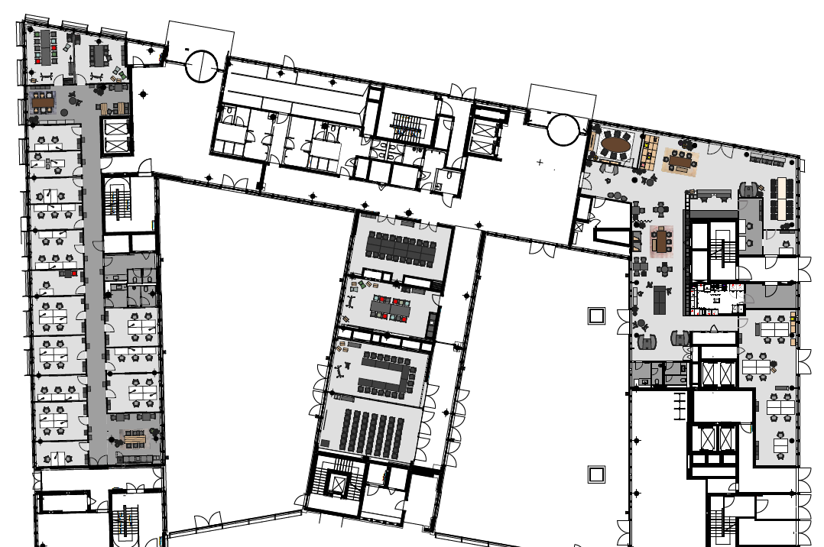
Ground Floor
With flexible walls
Meeting & Conference Spaces
Office Spaces
Training Room I
Training Room II
Training Room III
Meet & Move Room
Training Room V
Fireside Room
DO.Lounge
Reception
6
COMING SOON
8
7
1
5
2
4
3
4
2
3
5
1
LOCATION INFORMATION
6
7
8

Slide 3







Ground Floor
Seating Plan
 | m² | L x W x H in metres | New Work | U-shaped | Parliamentary | Theatre | Block | Circle | Banquet
Training Room I | 56 | 5.7 x 9.9 x 3.2 | 30 | 18 | 24 | 40 | 16 | 20
Training Room II | 56 | 5.7 x 9.9 x 3.2 | 30 | 18 | 24 | 40 | 16 | 20
Training Room III | 112 | 11.5 x 9.9 x 3.2 | 70 | 26 | 60 | 110 | 24 | 40
Meet & Move Room | 47 | 4.9 x 9.6 x 3.2 |  |  |  |  | 12
Training Room V | 55 | 5.7 x 9.6 x 3.2 | 30 | 16 | 18 | 40 | 16 | 20
Fireside Room | 20 | 4.0 x 5.0 x 3.2 |  |  |  |  | 6
DO.Lounge | 243 |  | Community table, workspaces, lounge furniture for 100 people
Reception
1
2
3
4
5
LOCATION INFORMATION
6
7
8

Slide 4
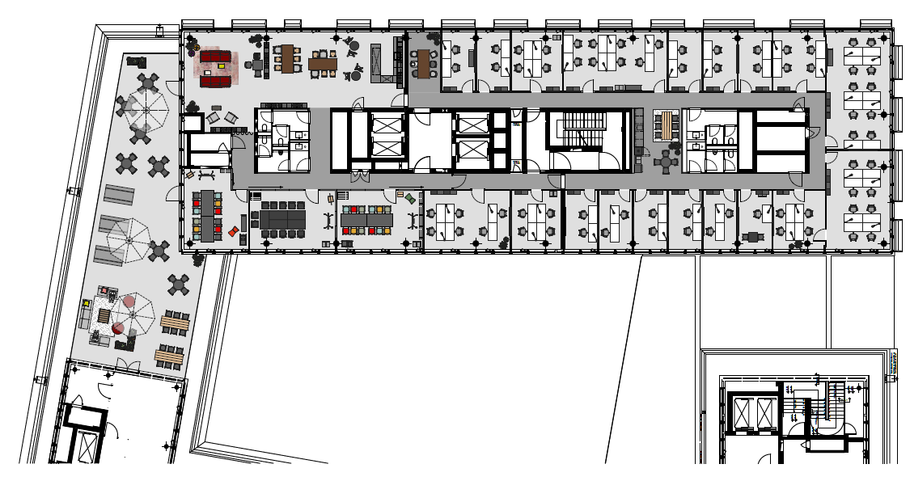
6th Floor
With felxible walls
Meeting & Conference Spaces
Office Spaces
7
Training Room VI
Training Room VII
Training Room VIII
Training Room IX (VII + VIII)
Training Room X (VI + VII)
Training Room XI (VI, VII, VIII)
Rooftop Lounge + Terrace
Rooftop Terrace
8
1
3
2
1
4
5
2
6
3
4
5
LOCATION INFORMATION
6
7
8

Slide 5
6th Floor
Seating Plan
 | m² | L x W x H in metres | New Work | U-shaped | Parliamentary | Theatre | Block | Circle | Banquet
Training Room VI | 30 | 6.6 x 4.6 x 2.9 |  |  | 10 | 16 | 10 | 10
Training Room VII | 30 | 6.6 x 4.6 x 2.9 |  |  | 10 | 16 | 10 | 10 | 30
Training Room VIII | 29 | 5.0 x 6.2 x 2.9 |  |  | 10 | 16 | 10 | 10
Training Room IX (VII + VIII) | 59 | 13.2 x 4.6 x 2.9 | 40 |  | 24 | 30 | 18 | 20
Training Room X (VI + VII) | 61 | 11.7 x 4.6 x 2.9 | 40 |  | 24 | 30 | 18 | 20
Training Room XI (VI, VII, VIII) | 90 | 18.5 x 4.6 x 2.9 | 60 |  | 26 | 90 | 24 | 30
Rooftop Lounge + Terrace | 107 | 17.0 x 6.0 | 7.7 x 2.9 | Lounge and bistro furniture for 100 people
Rooftop Terrace
1
2
3
4
5
LOCATION INFORMATION
6
7
8

